Slide 1

Top Five IT MNCs and Their Roles in the World's Economy Subject: Information Technology
Presented by: Harshit Sinha Class: 9 ‘C’ Roll No.: 42

Slide 2
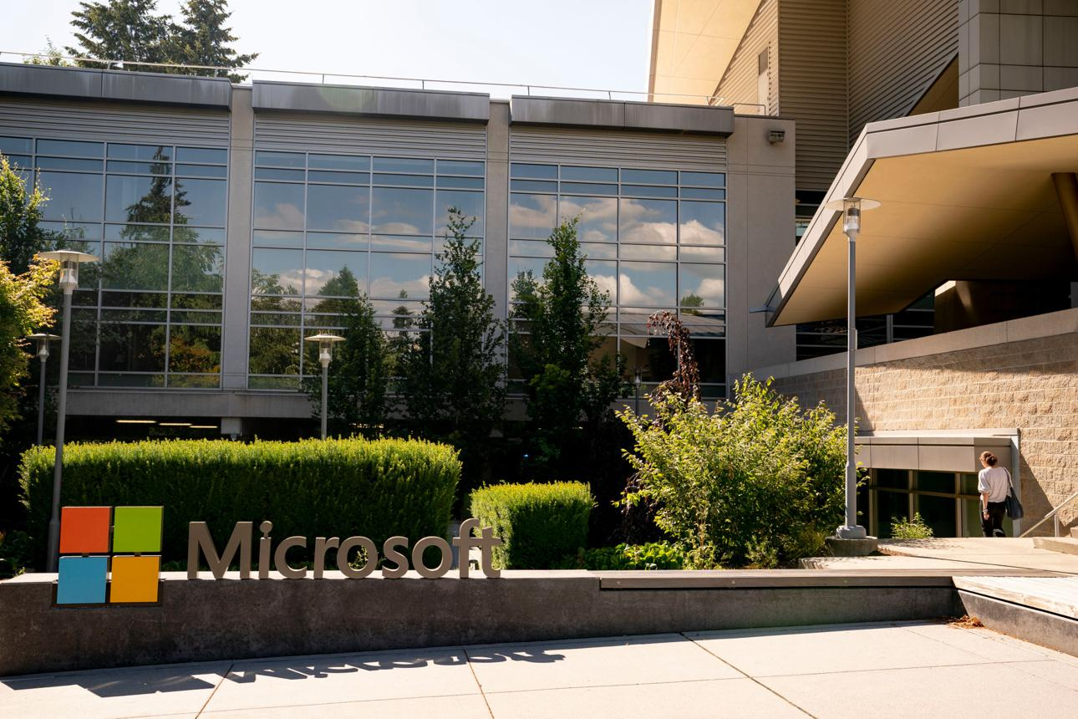
Microsoft Corporation
Founded: 1975
Headquarters: Redmond, Washington, USA
Founders: Bill Gates and Paul Allen
Major Products: Windows, Microsoft Office, Azure Cloud Services, Teams
What Microsoft Does:
Develops the Windows operating system.
Creates productivity software such as Microsoft Office.
Provides cloud computing services through Azure.
Offers business communication tools like Microsoft Teams.

Slide 3
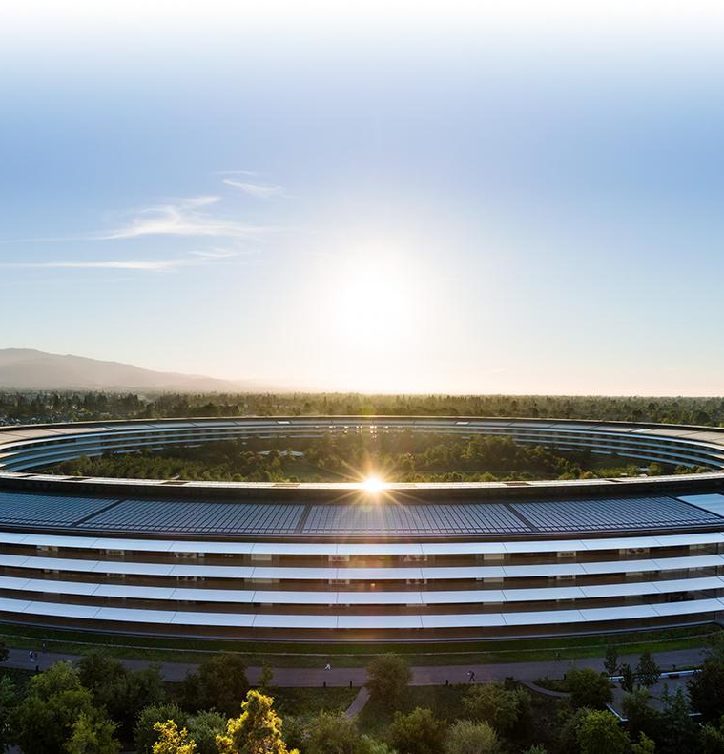
Apple Incorporation
Founded: 1976
Headquarters: Cupertino, California, USA
Founders: Steve Jobs, Steve Wozniak, and Ronald Wayne
Major Products: iPhone, MacBook, iPad, Apple Watch
What Apple Does:
Designs and manufactures iPhones, iPads, and Mac computers.
Develops operating systems such as iOS and macOS.
Provides digital services like the App Store and iCloud.
Creates wearable devices such as the Apple Watch.

Slide 4
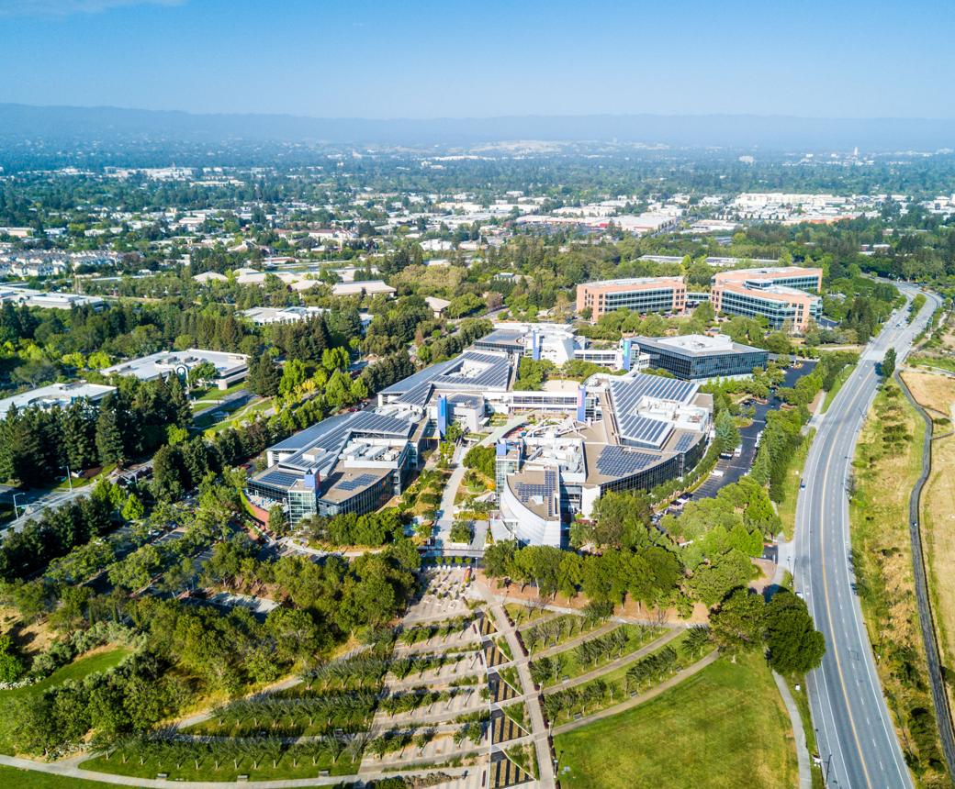
Google (Alphabet Inc.)
Founded: 1998
Headquarters: Mountain View, California, USA
Founders: Larry Page and Sergey Brin
Major Services: Google Search, Gmail, YouTube, Android, Google Cloud
What Google Does:
Operates the Google Search Engine.
Provides email services through Gmail.
Develops the Android operating system.
Owns YouTube, one of the world's largest video platforms.

Slide 5

Amazon Web Services (AWS)
Parent Company: Amazon
Founded: 2006 (AWS)
Headquarters: Seattle, Washington, USA
Founder of Amazon: Jeff Bezos
What AWS Does:
Provides cloud storage and computing services.
Hosts websites and applications for businesses.
Supports startups and large enterprises with IT infrastructure.
Offers databases, networking, and security solutions.

Slide 6
IBM (International Business Machines)
Founded: 1911
Headquarters: Armonk, New York, USA
Major Services: Artificial Intelligence, Cloud Computing, Consulting, Cybersecurity
What IBM Does:
Provides IT consulting services.
Develops artificial intelligence solutions.
Offers cloud computing services.
Conducts research in emerging technologies such as quantum computing.
Helps businesses improve their technology systems.

Slide 7
Thank You!

